Slide 1
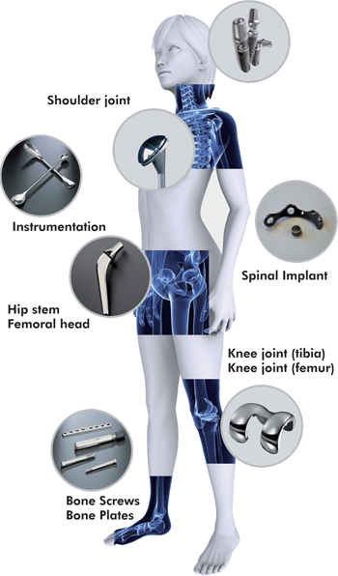
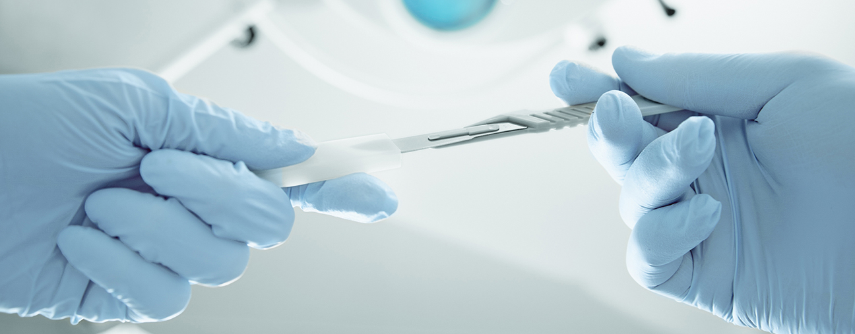
Novatec Cleaning Systems profile confidentially prepared for:
Smith & Nephew, Inc.

Slide 2
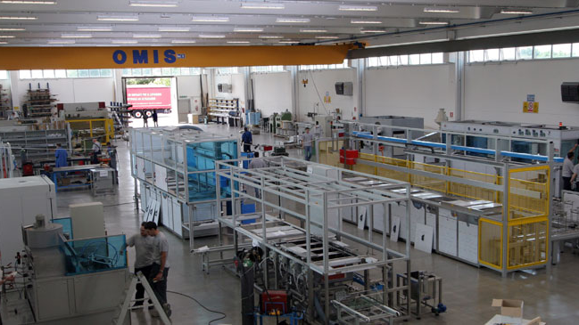
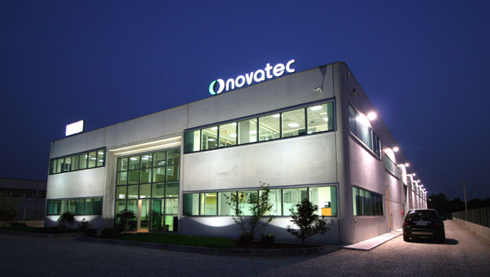
Established in 1993, Novatec designs and manufactures precision ultrasonic cleaning system solutions in San Martino di Lupari, Italy.

Slide 3
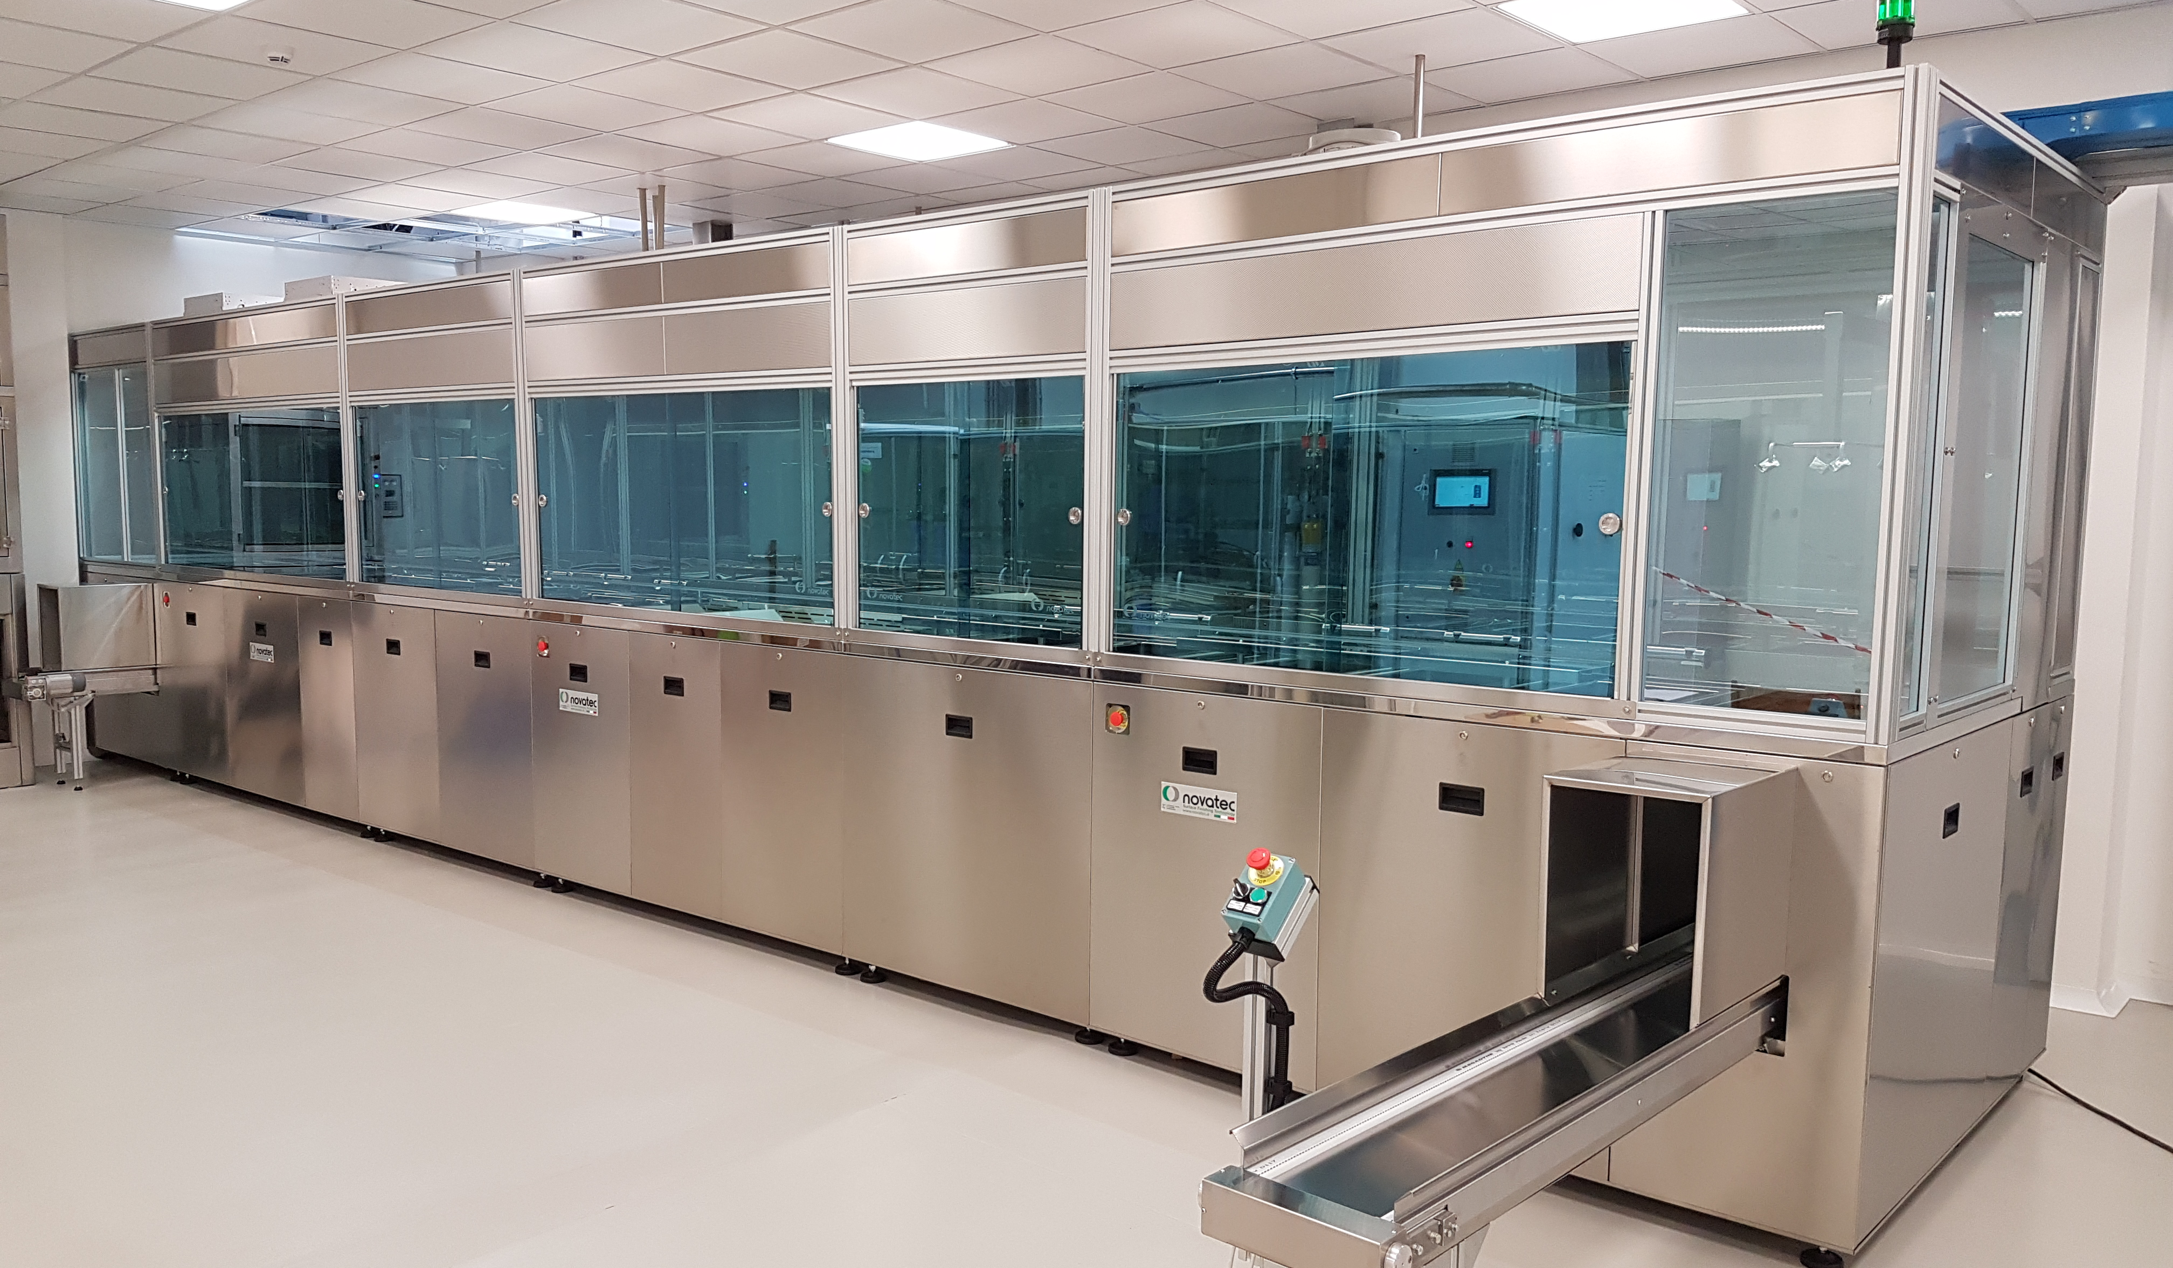
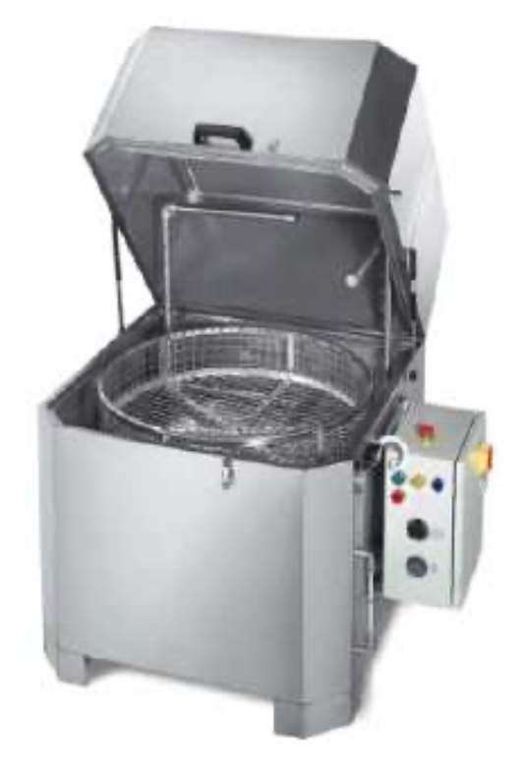
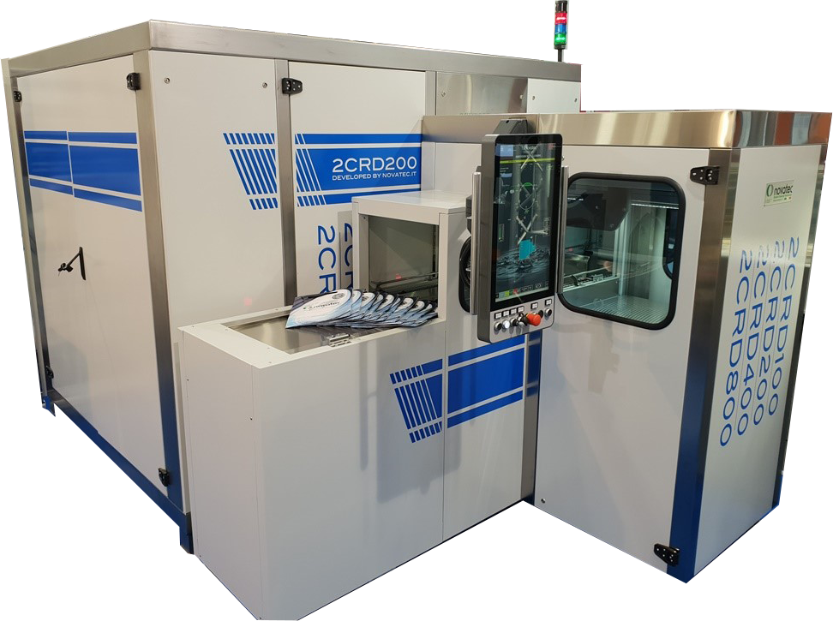
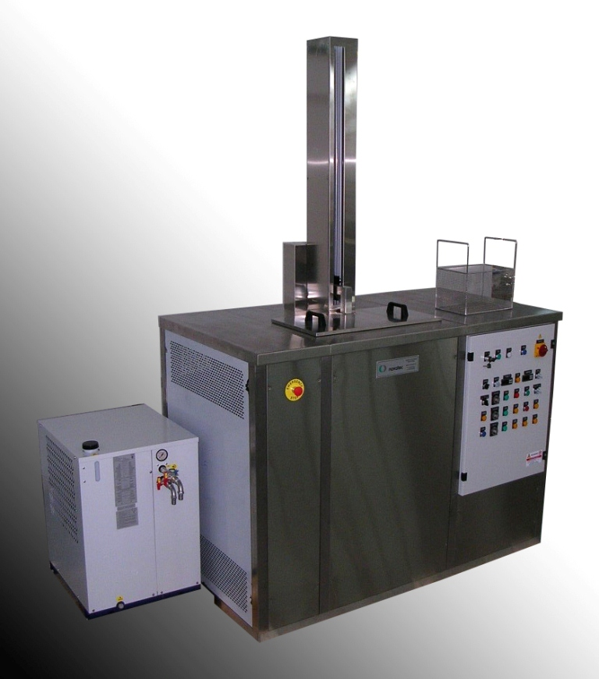
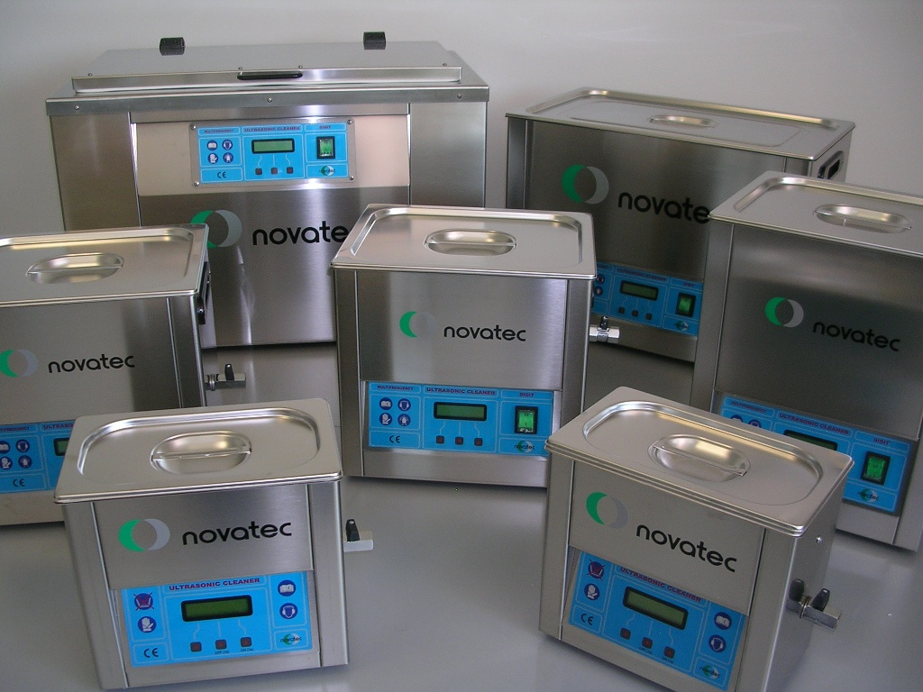
The Novatec range includes: Precision ultrasonic lines, single chamber vacuum, vapor degreasing & solvent systems, portable sonic and rotary spray wash units

Slide 4
Novatec’s Global Installation Presence & Service Network Locations
Greenland
Svalbard
Alaska
Canada
Iceland
Sweden
Finland
Russia
Faroe Islands
Norway
Estonia
Denmark
Latvia
Ireland
UK
Germany
Poland
Lithuania
France
Ukraine
Kazakhstan
Mongolia
USA
Romania
Uzbekistan
North Korea
Portugal
Spain
Italy
Greece
Turkey
Turkmenistan
China
South Korea
Japan
Azores
Morocco
Malta
Syria
Iraq
Iran
Afghanistan
Kashmir
Madeira Island
Mexico
Belize
The Bahamas
Canary Islands
Algeria
Libya
Egypt
Saudi Arabia
Pakistan
Nepal
Cuba
Dominican Republic
Western Sahara
Oman
India
Myanmar
Laos
Hawaiian Islands
Jamaica
Cape Verde
Mauritania
Mali
Niger
Chad
Yemen
Thailand
Guatemala
Nicaragua
Guyana
Senegal
Guinea
Burkina Faso
Nigeria
Sudan
Vietnam
Philippines
Guam
El Salvador
San Jose
Venezuela
Suriname
Sierra Leone
Central
African
Republic
Ethiopia
Honduras
Panama
Columbia
French Guiana
Liberia
Cameroon
Uganda
Somalia
Malaysia
Ecuador
Cote d’Ivoire
Gabon
Democratic Republic of the Congo
Kenya
Papua New Guinea
Galapagos
Ghana
Congo
Tanzania
Seychelles
Indonesia
Peru
Brazil
Angola
Mozambique
Solomon Islands
Bolivia
Zambia
Vanuatu
Namibia
Botswana
Zimbabwe
Madagascar
Mauritius
Fiji
Paraguay
Reunion
Australia
New Caledonia
Argentina
Uruguay
South Africa
Chile
Falkland Islands
Kerguelen Island
Tasmania
New Zealand
South Georgia
Heard Island

Slide 5
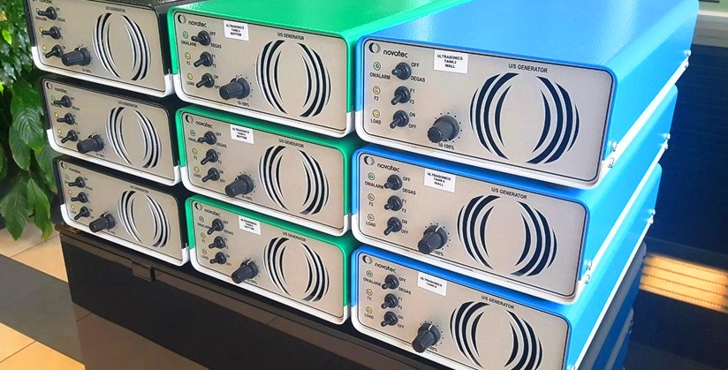
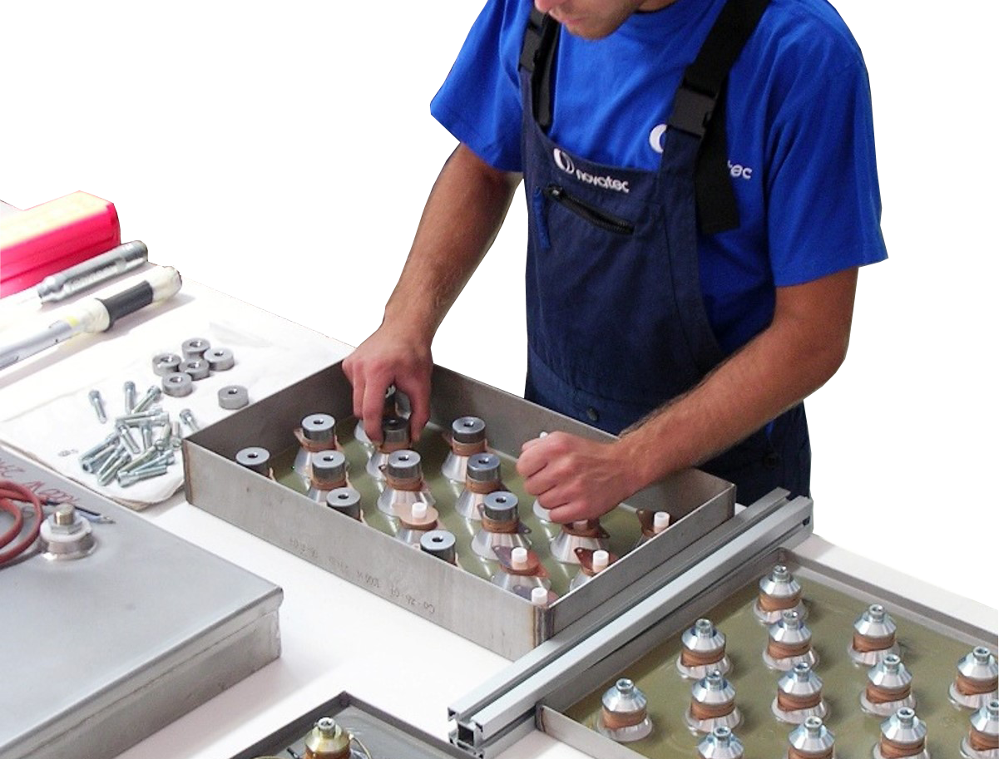
Novatec controls all aspects of design and manufacturing including production of its own Generators and Transducers

Slide 6
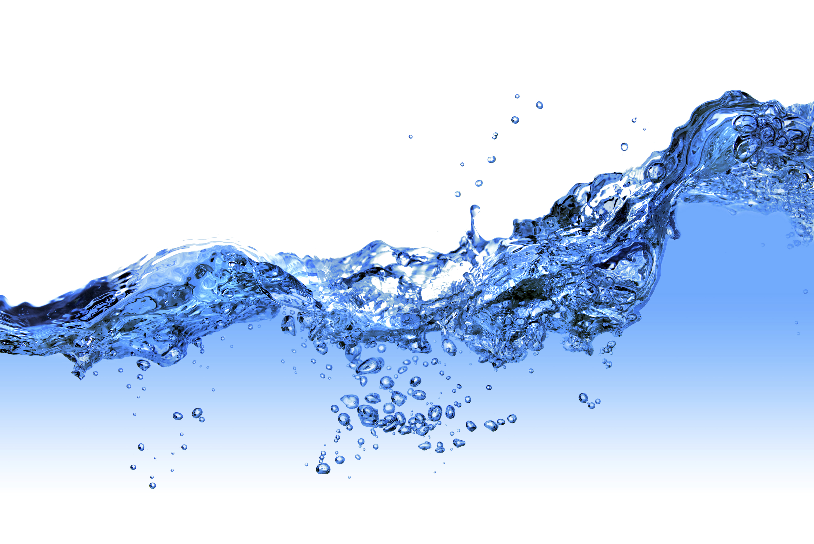
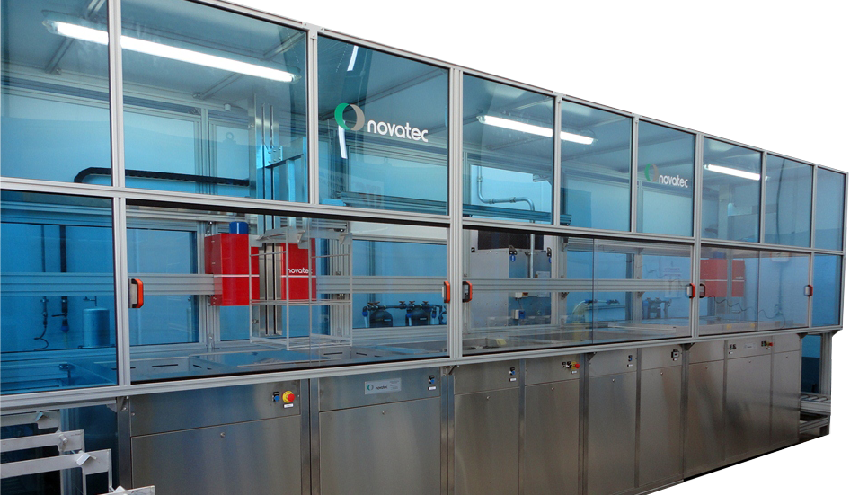
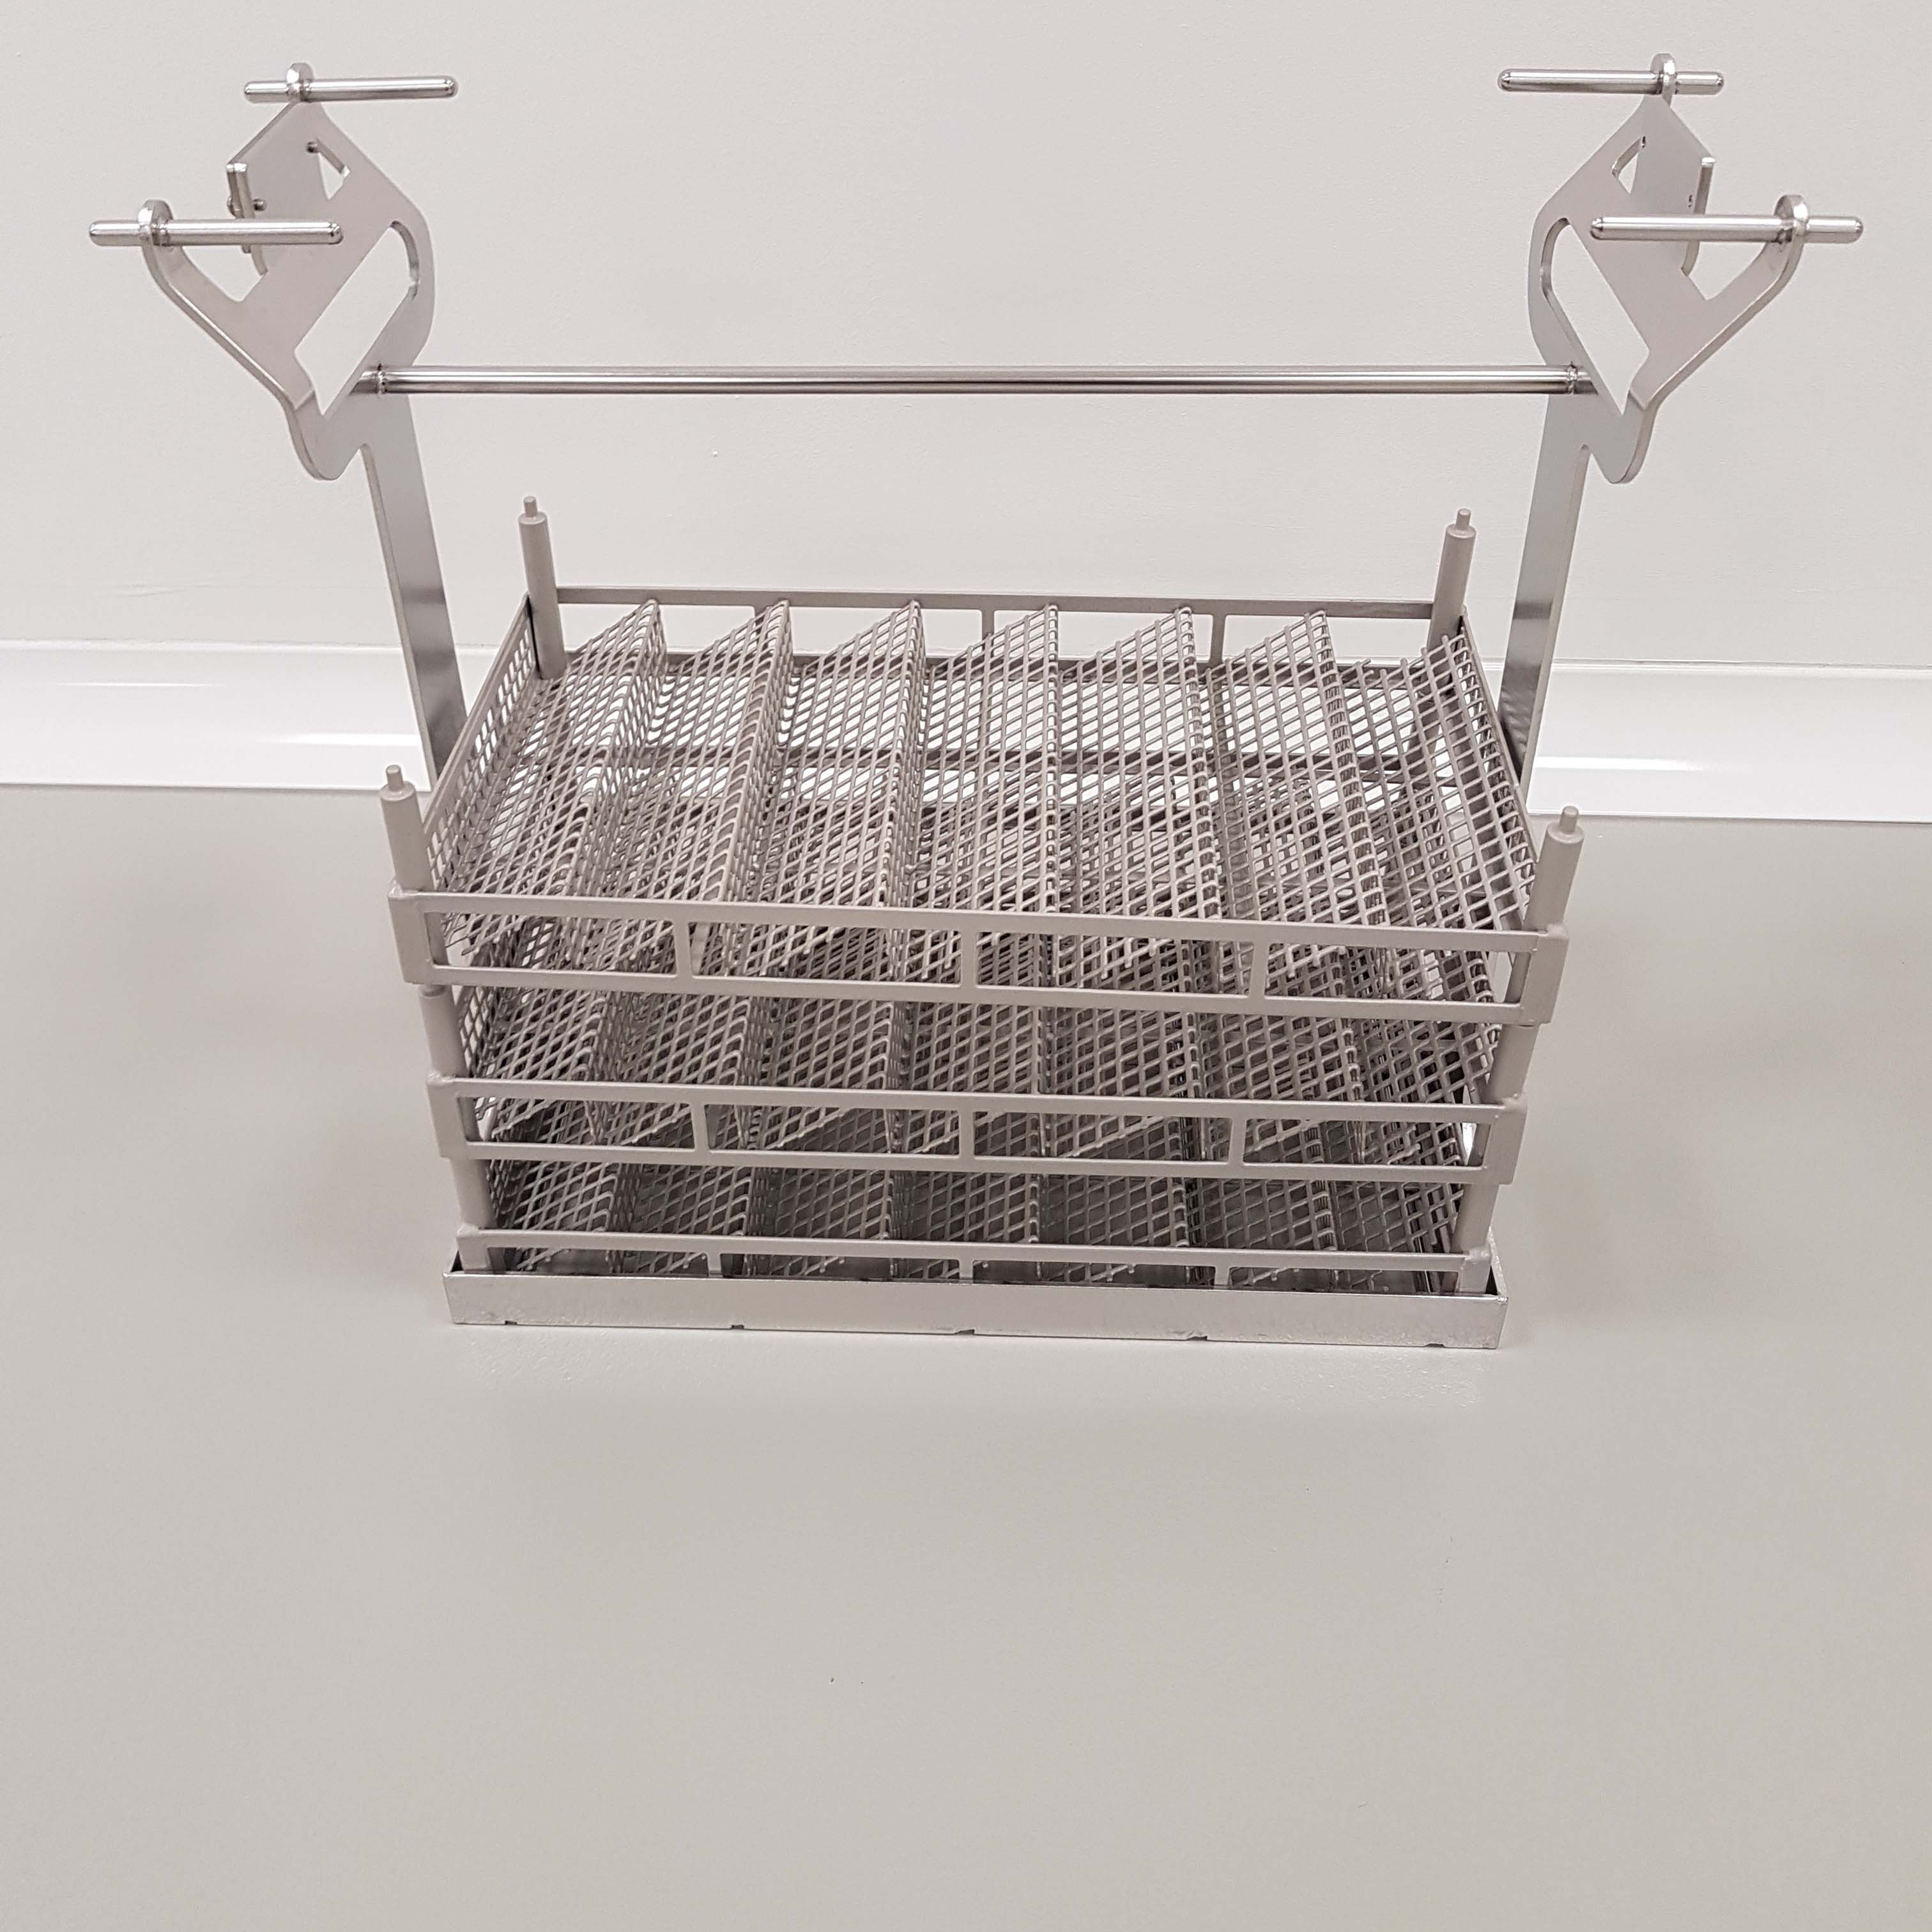
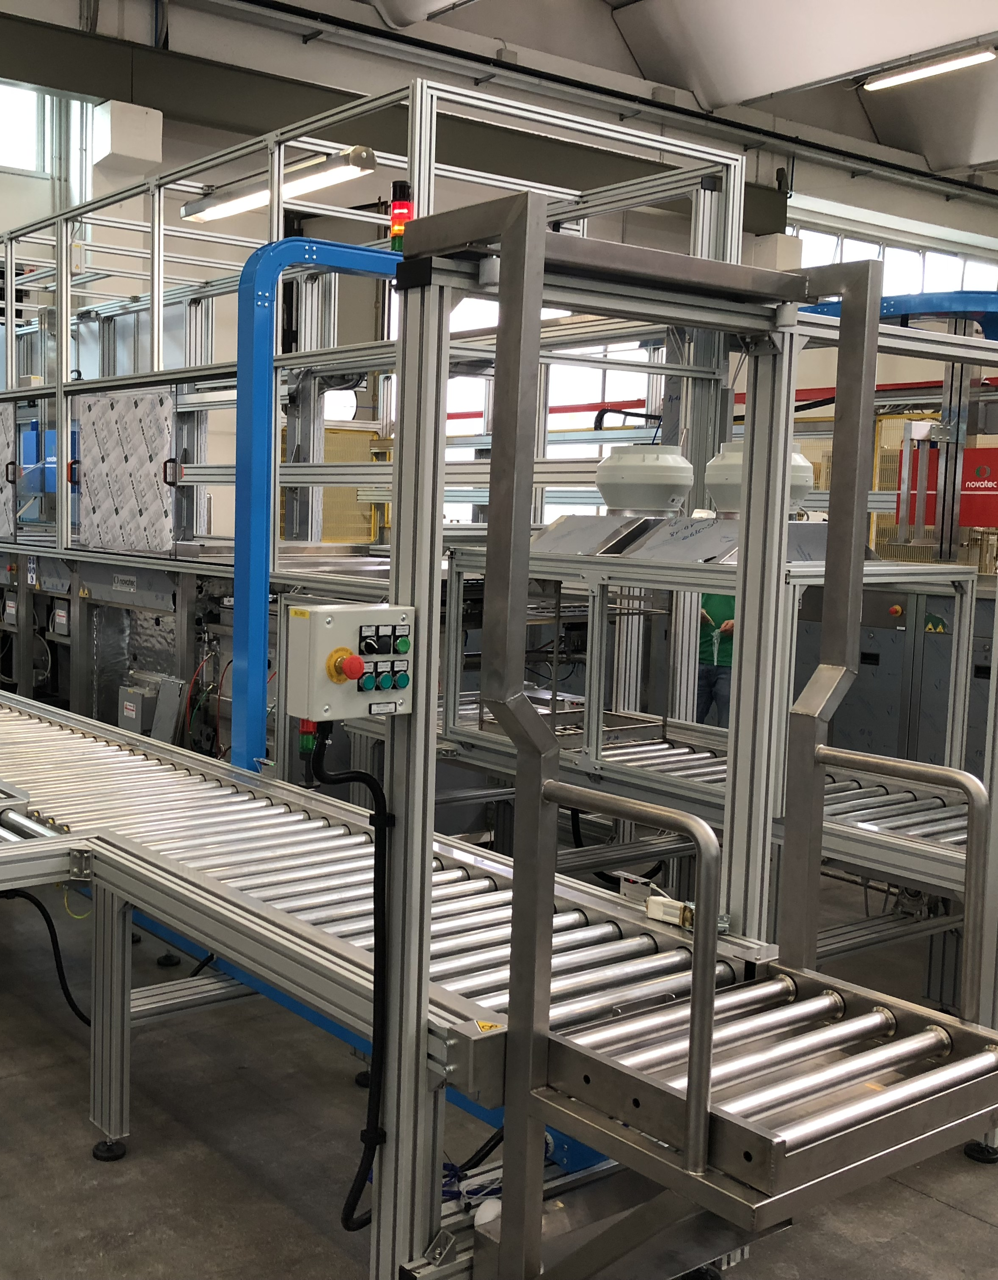
Novatec offers automation, conveyance and workholding solutions

Slide 7
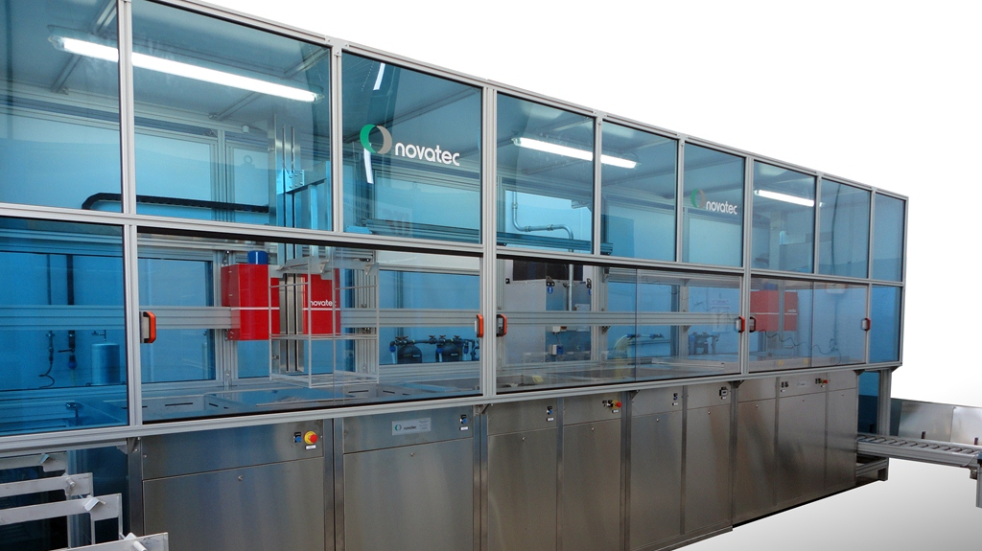
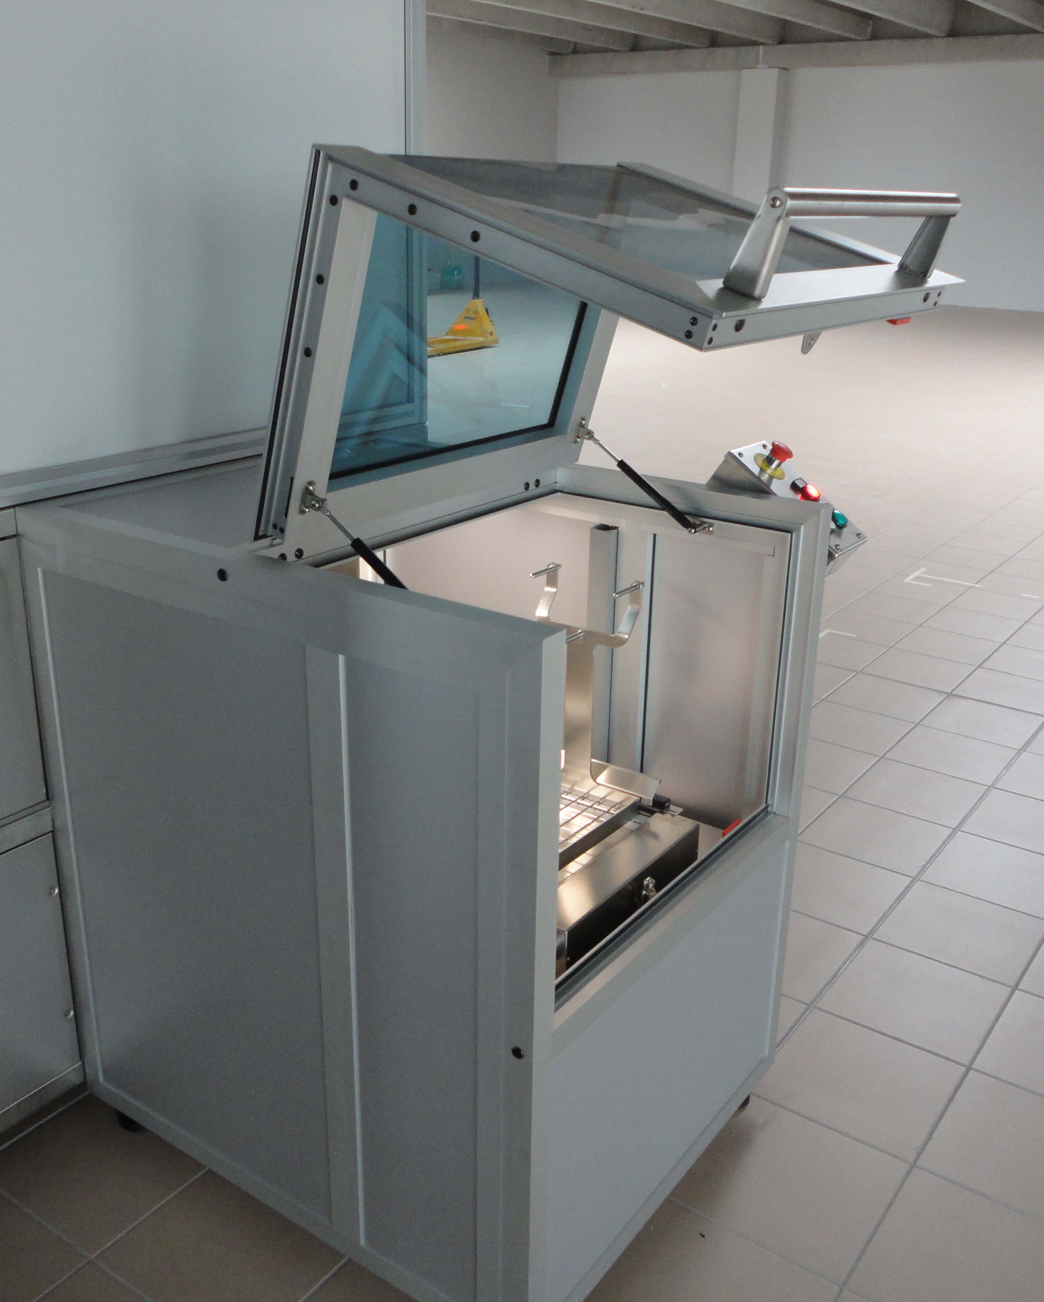
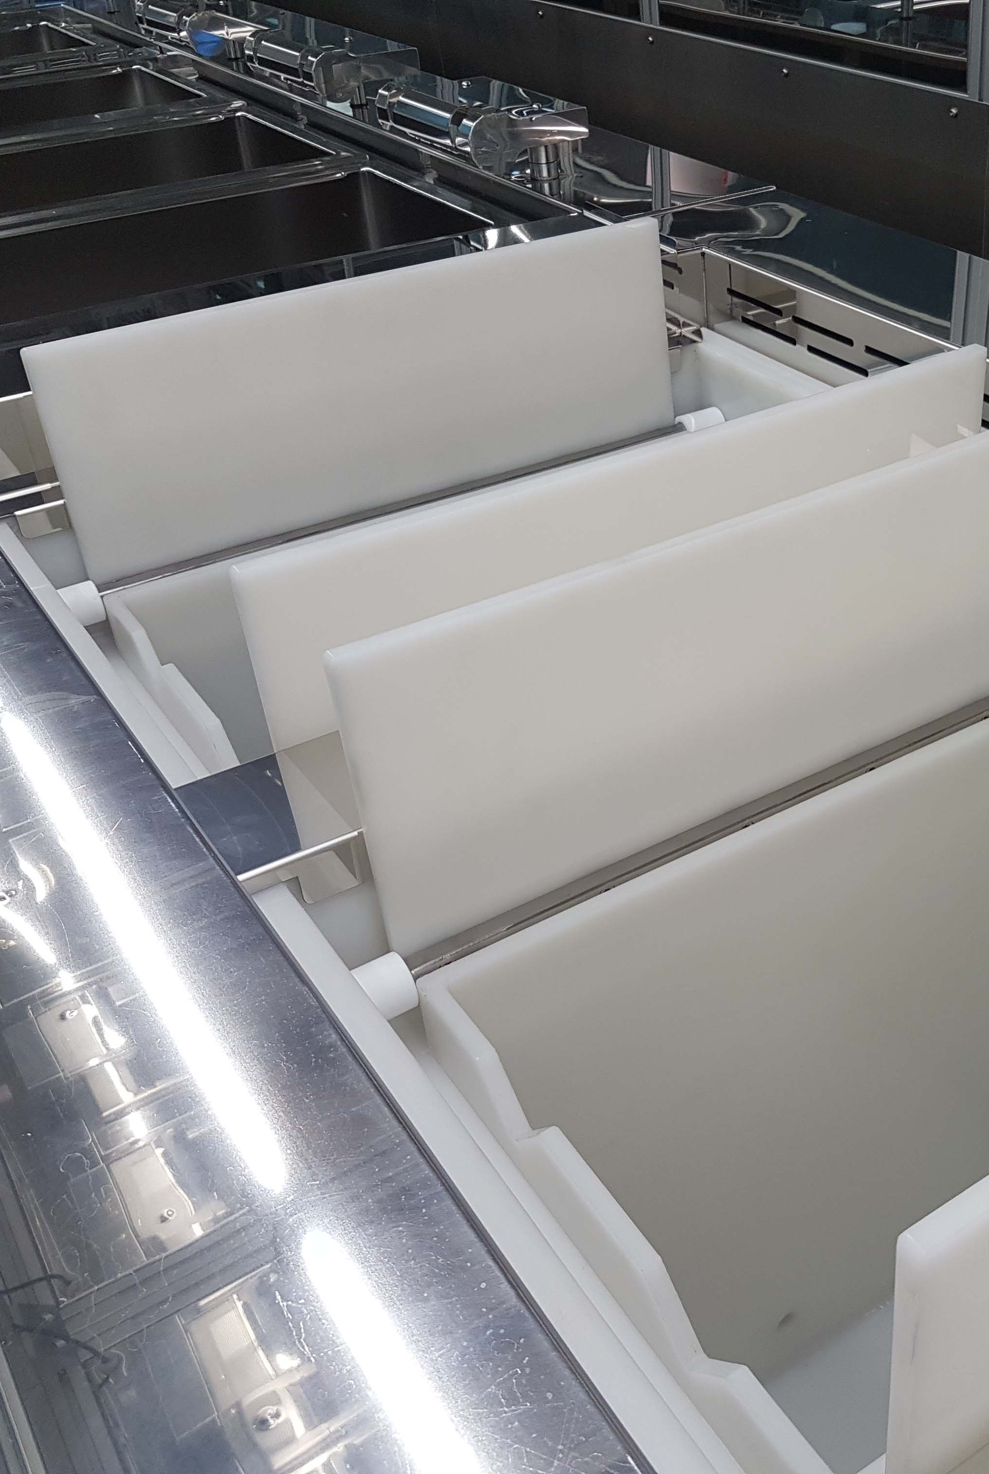
The Pluritank Series:
Automated and manual multi-tank precision cleaning solutions.
Features include: hard and soft process control systems for final clean, passivation, vacuum cleaning and drying, vapor degreasing and clean room integration.

Slide 8
Pluritank Clean & Passivation with optional vacuum ultrasonic clean, vacuum and convection drying, integrated vapor degreasing.
Vapor Degreasing Systems in manual anduutt
Models 1S, 2S & 3S

Slide 9
ec
.
Novatec nitric passivation versions feature separate dedicated acid fume extraction in addition to main enclosure ventilation system

Slide 10
Pluritank Clean & Passivation system custom designed to install around existing system allowing continued production while in validation.
Includes integrated vapor degreasing.
Vapor Degreasing Systems in manual anduutt
Models 1S, 2S & 3S

Slide 11
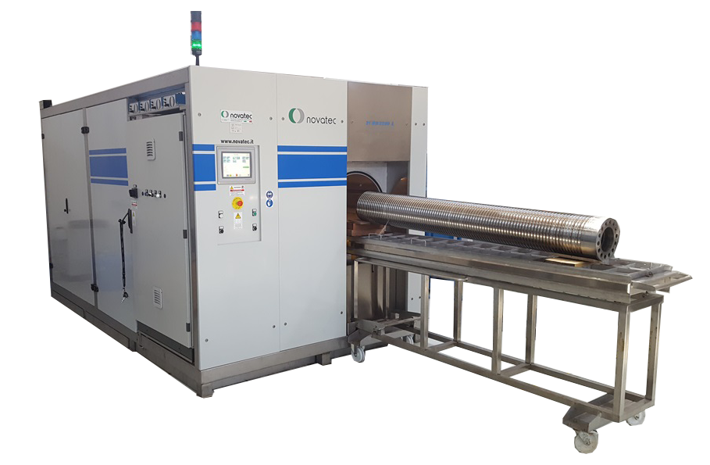
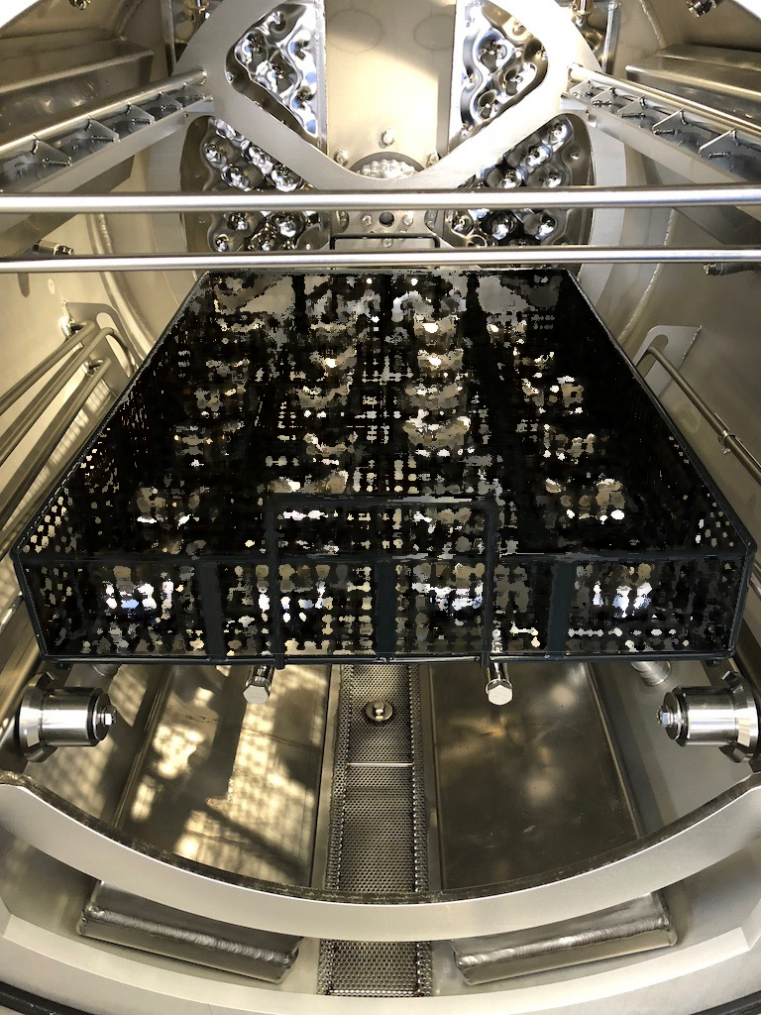
The CRD Series:
Single Chamber Acqueous Vacuum Ultrasonics
Features include: Parameter driven process control of immersion ultrasonics, rotation, spray, vacuum agitation, hot air and vacuum drying

Slide 12
CRD Models: 100 200 400 800 + Custom
Chamber Sizes: 300 x 400 x 300 400 x 600 x 430 500 x 820 x 500 600 x 1050 x 630
Shown: CRD 400 - Autoload
Vapor Degreasing Systems in manual and automated verions.
Models 1S, 2S & 3S

Slide 13
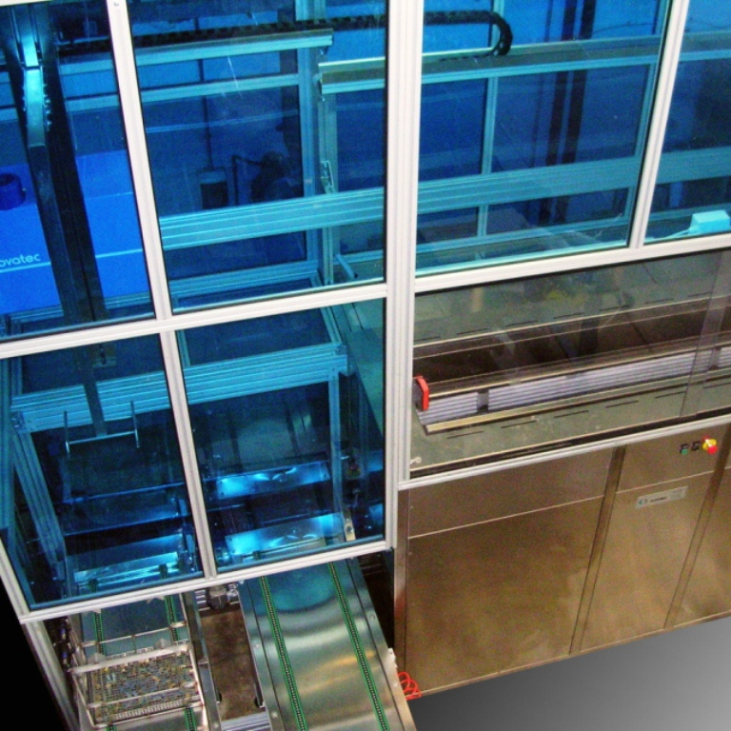
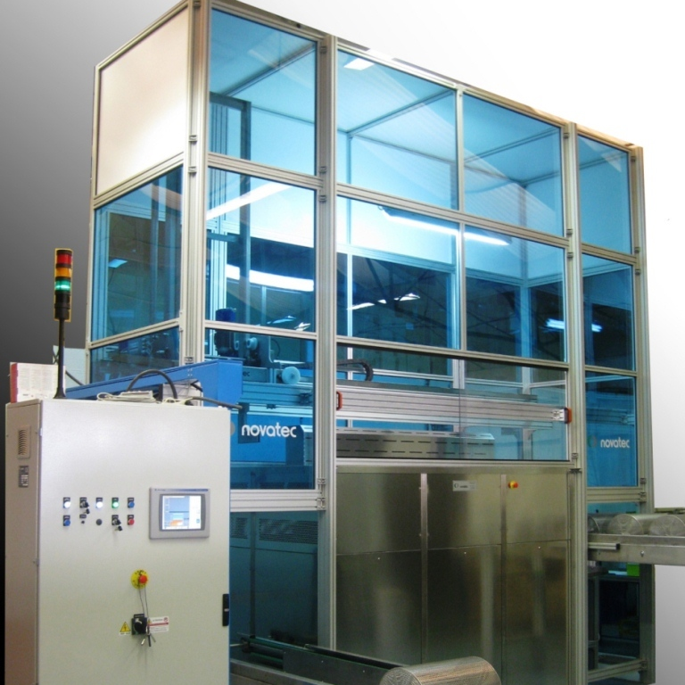
Novatec Solvent cleaning systems in manual, automated and system integrated versions. Solvent cleaning optional ultrasonics and vapor rinse. Standard and custom units.

Slide 14
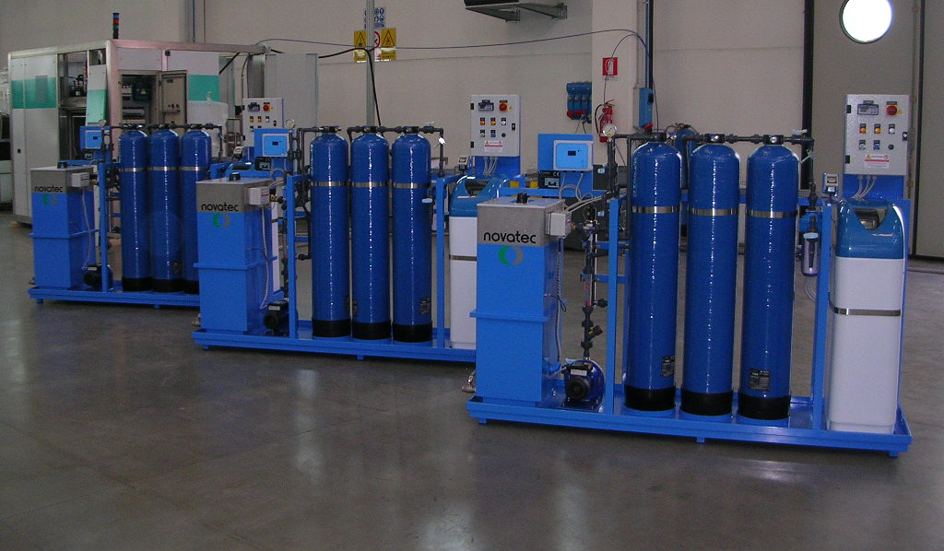
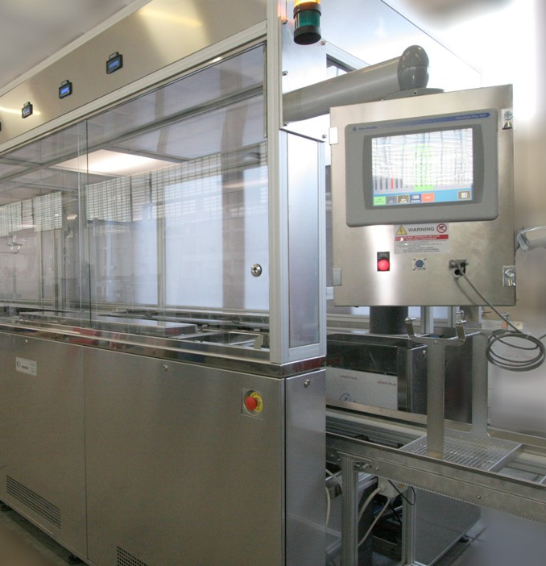
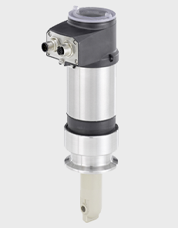
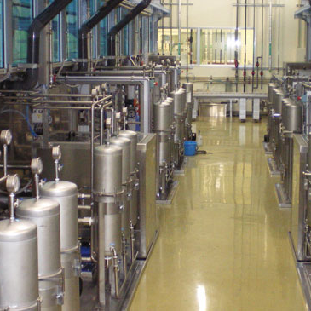
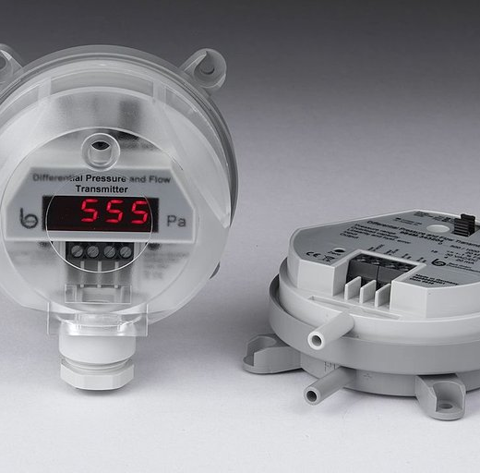
Monitor, measure and manage. Process parameter recording and control.
Vapor extraction, filtration, preconditioning and deionizing systems

Slide 15
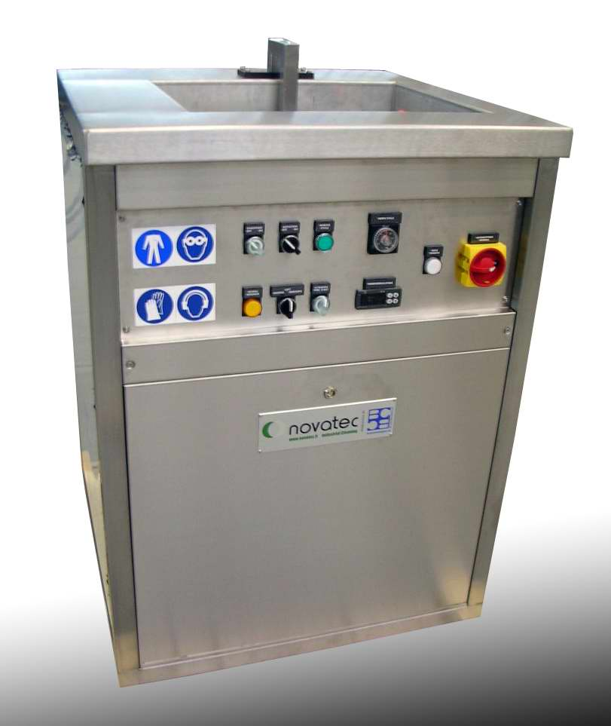
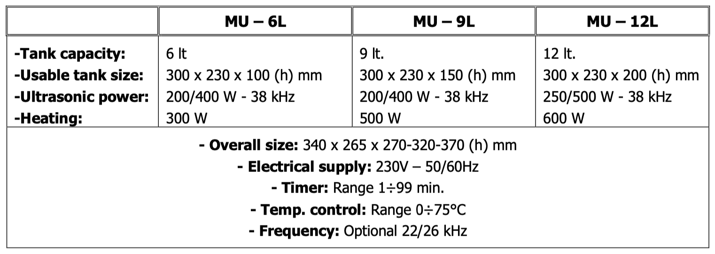
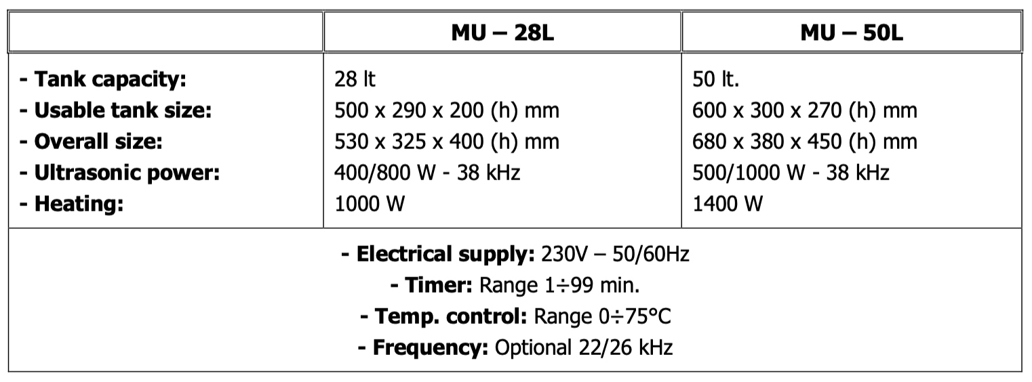
Table Top Portable Ultrasonics & Custom Single Units

Slide 16
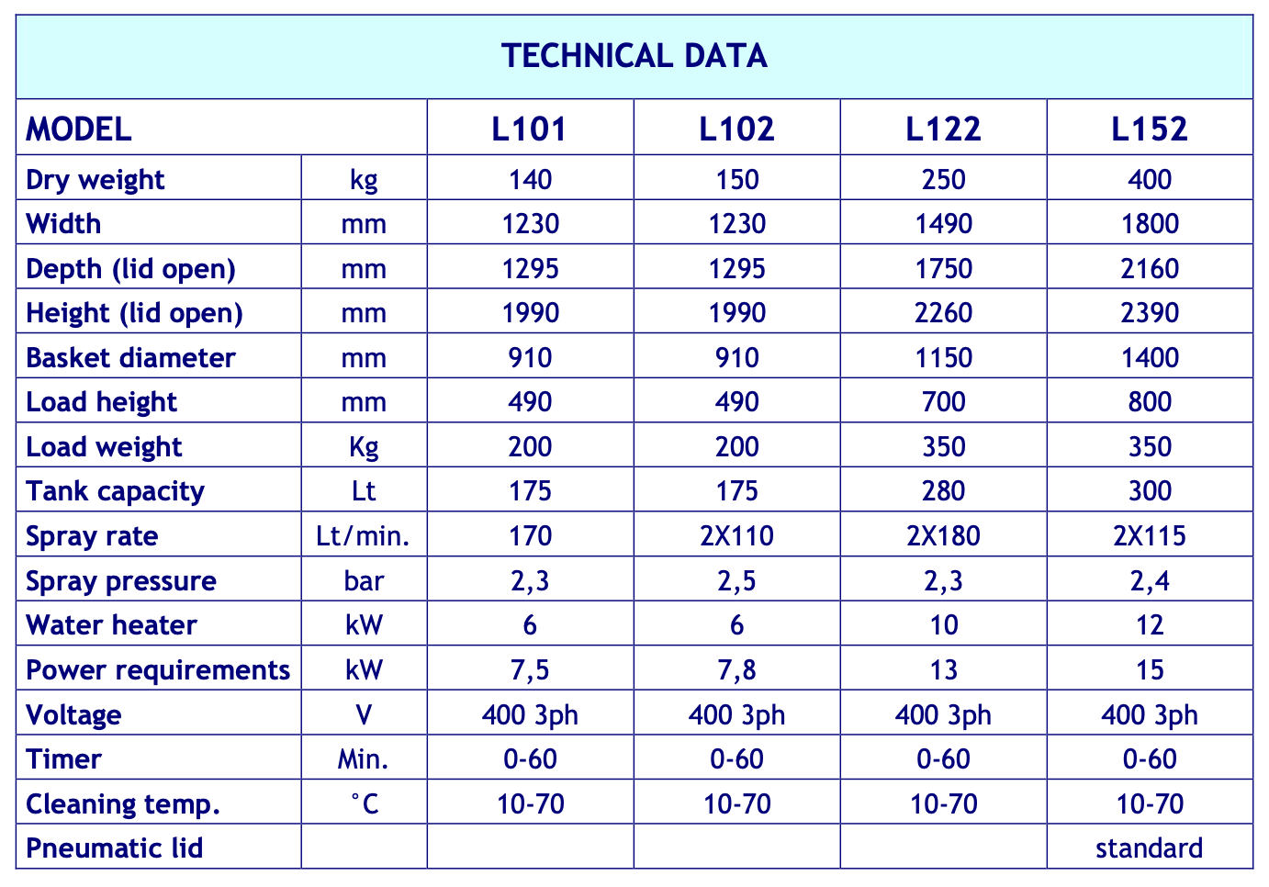
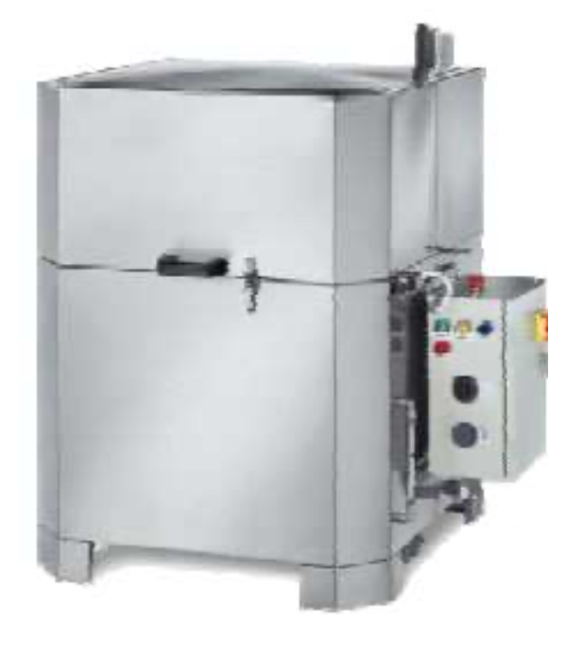
Rotary Spray Wash Units

Slide 17
RELAVENT COOPERATIONS

Slide 18
A GLOBAL PIONEER IN EFFICIENT AQUEOUS CLEANING CHEMISTRIES, NGL SHARES A COMMITMENT TO REDUCE CHEMICAL IMPACT ON THE ENVIRONMENT AND USERS’ HEALTH.

Slide 19
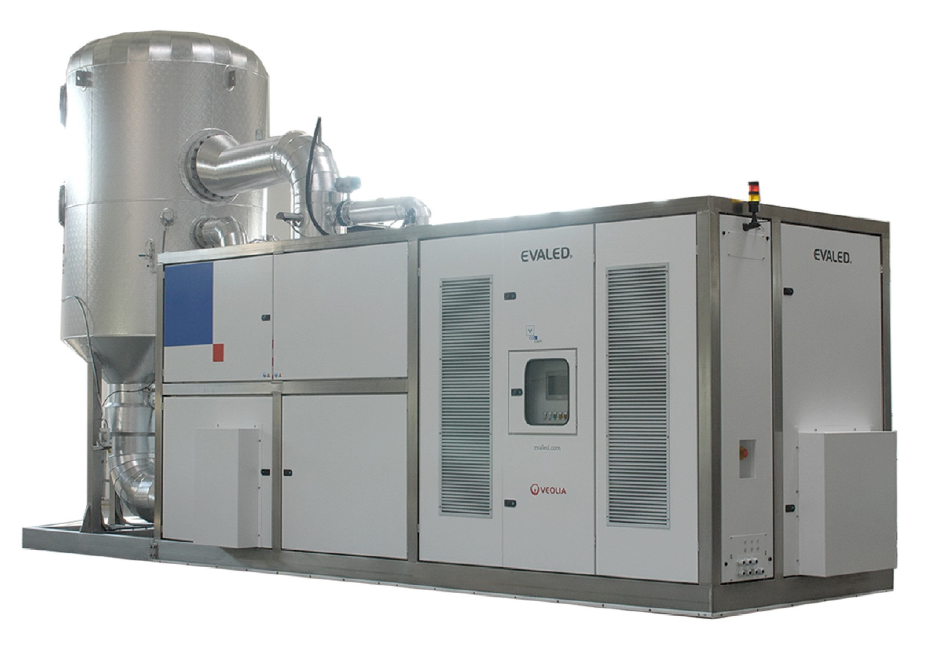
SUSTAINABLE EFFICIENCIES WITH CLOSED LOOP RECYCING OF EFFLUENT STREAMS. EFFICIENT UTILIZATION OF POWER AND VACUUM CREATE PRODUCTIVE SOLUTIONS TO WATER MANAGEMENT

